Slide 1
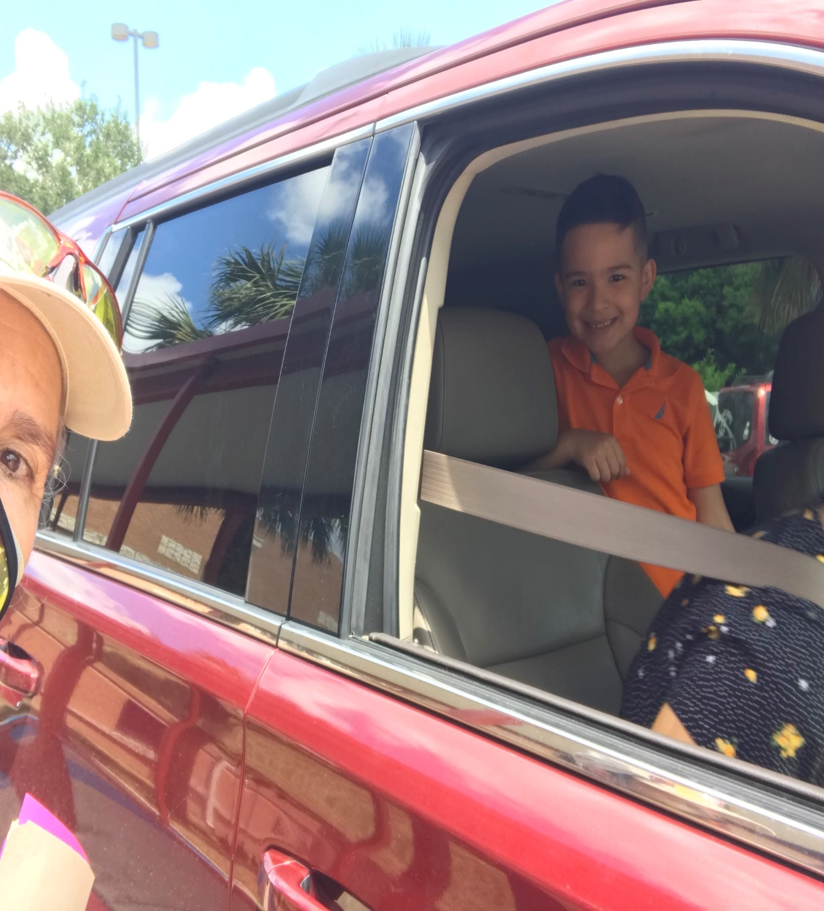
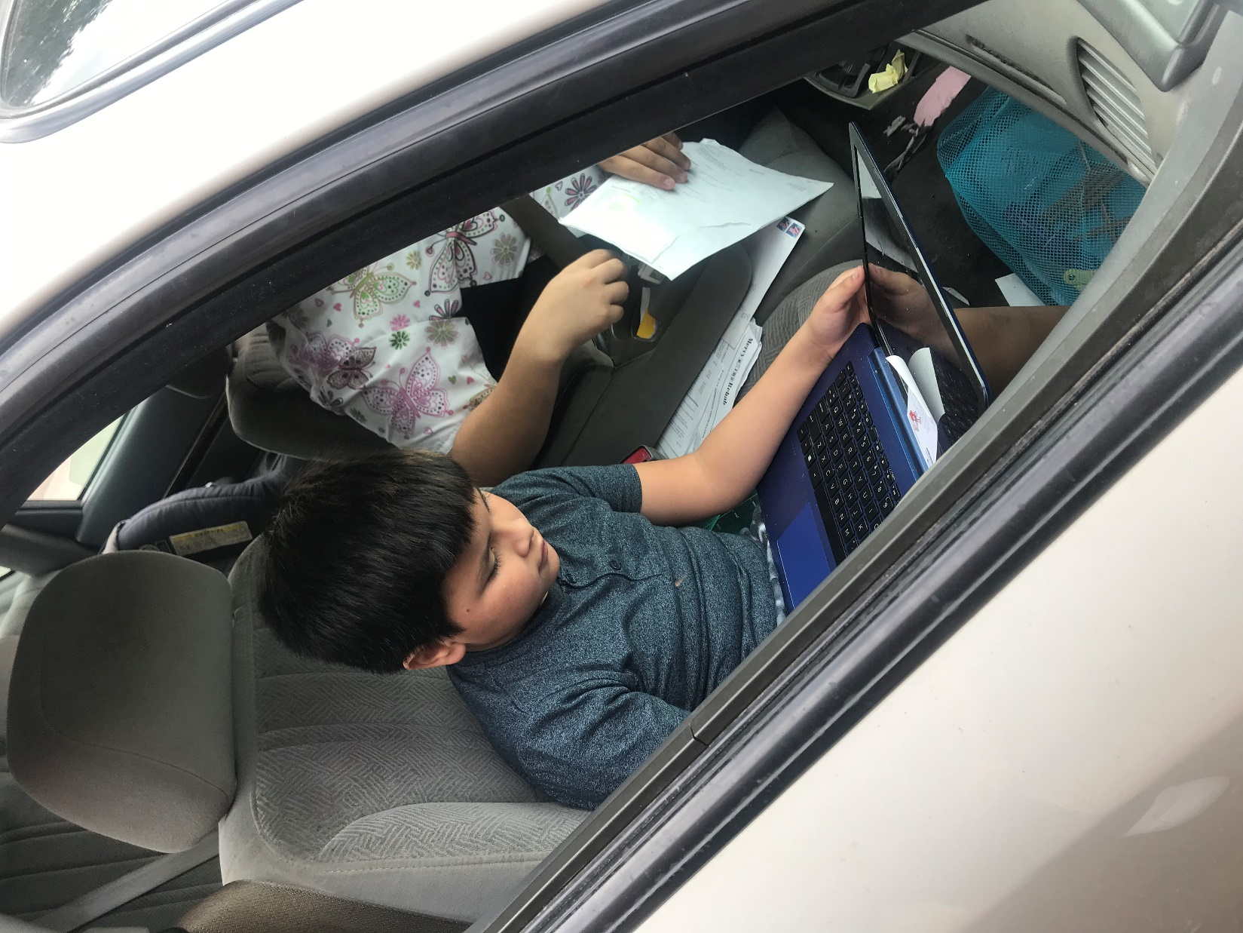
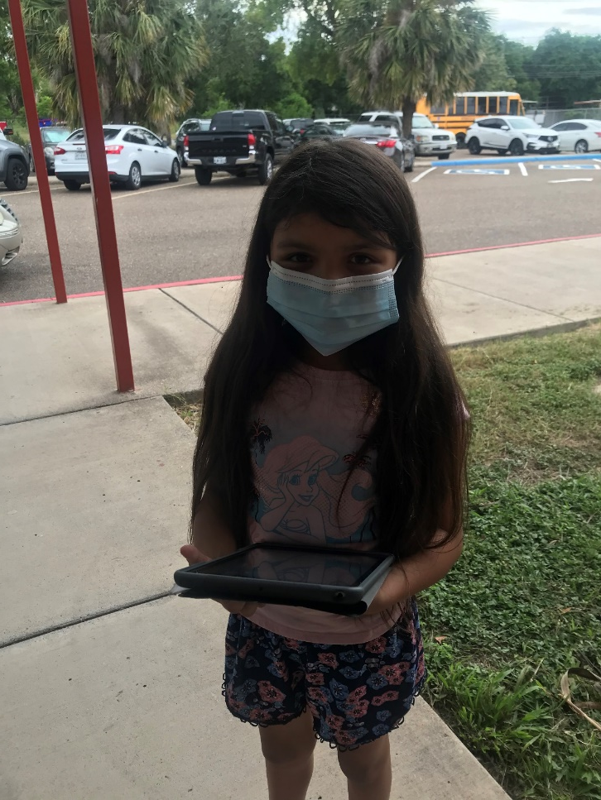
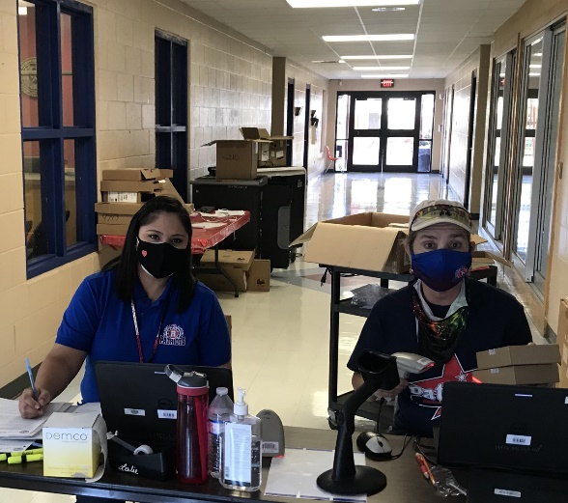
Welcome to your Virtual Russell Library
Mrs. B. Sosa, Librarian Mrs. G. Vasquez
bnsosa@bisd.us 956-698-1170

Slide 2
Student Online Rules & Etiquette
Dress appropriately, preferably in your school shirt and try to be in a quiet area.
Be prepared, on time and ready.
No food or drinks in area.
Be kind to others, wait your turn. If you have question raise your hand.
Mute microphone once meeting begins and throughout meeting, unless asked to unmute.
Have fun, and participate.

Slide 3
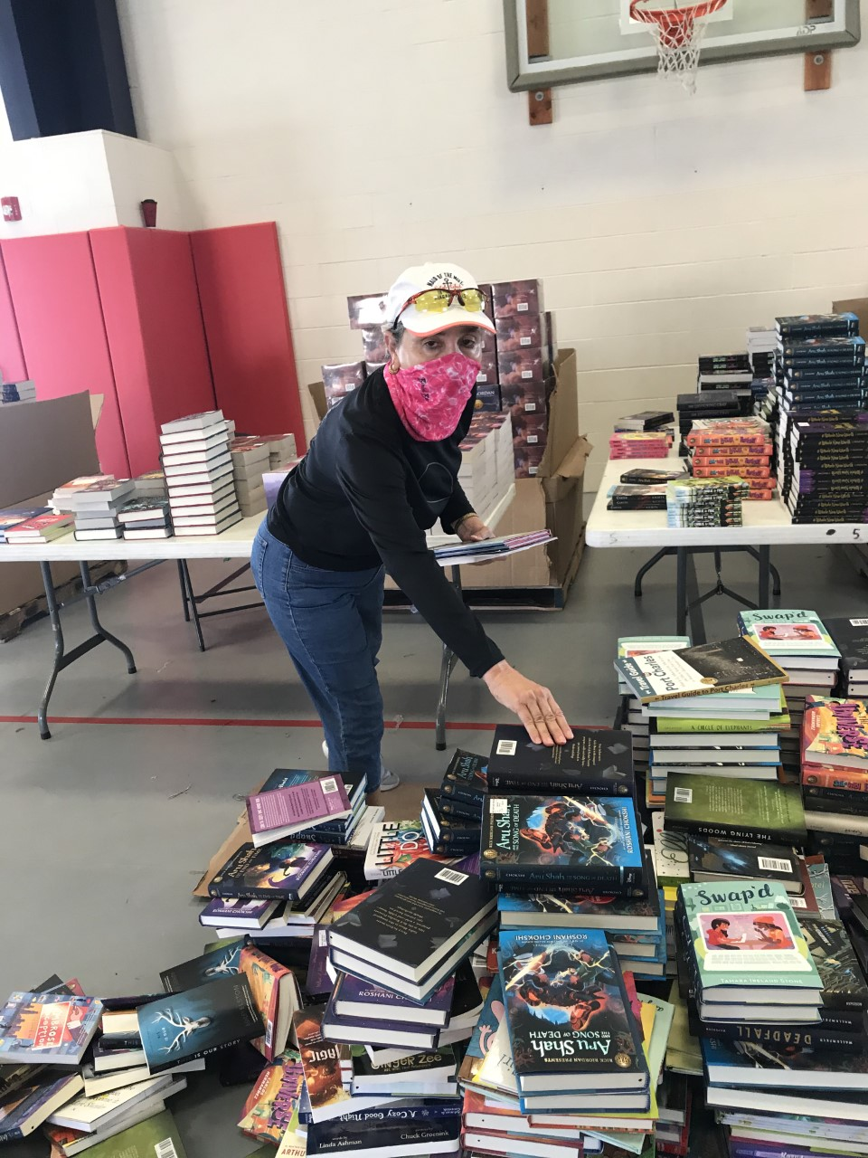
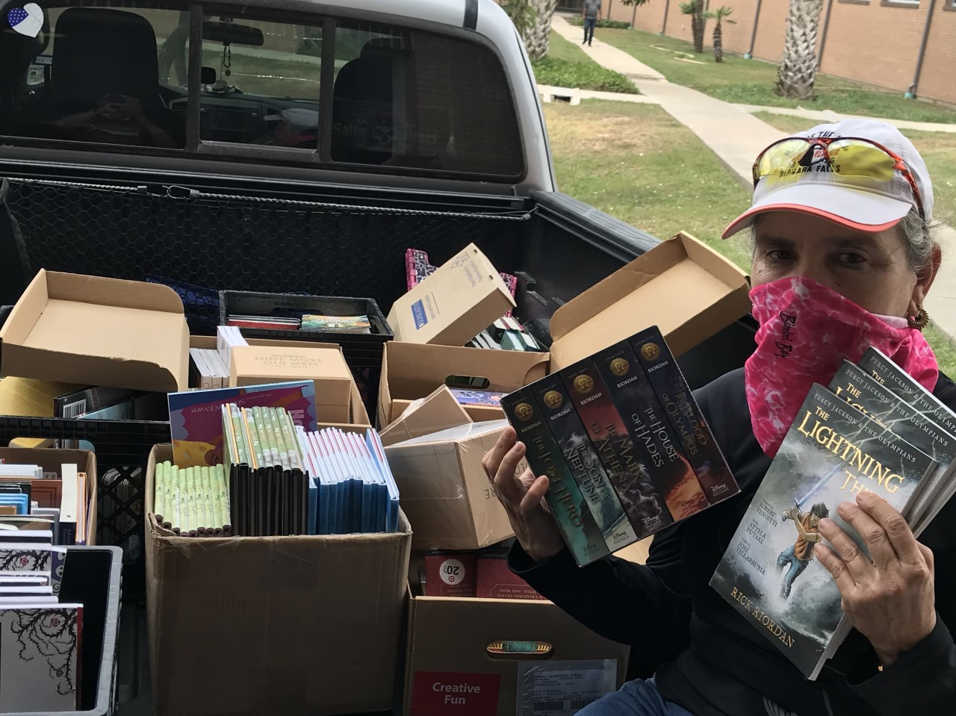
Reading Goal…….. AR Goals…………
Read at least, at least, a minimum of 1 book per week.

Slide 4
2020-2021 Media Center/Library Schedule
Library Schedule | Monday | Tuesday | Wednesday | Thursday | Friday
8:05-8:35 Synchronous 8:35-8:50 Asynchronous | Ru. Torres(1st) | Villalon(1st) | De La Garza(1st) | Coronado(1st) | Pecero(1st)
9:00-9:30Synchronous 9:30-9:45Asychronous | Luna(2nd) | Guerrero (2nd) | Infante(2nd) | Solis (2nd) | Check In/Out Books
9:45-10:15 Synchronous 10:15-10:30 Asynchronous | C. Torres(K) | Garza(K) | Binder(K) | Check In/Out Books | Check In/Out Books
10:30-11:15 | Planning | Planning | Planning | Planning | Planning
11:15-11:45 | Lunch
12:00-12:30 Synchronous 12:30-12:45 Asynchronous | Caballero(3rd) | Perez(3rd) | Cantu(3rd) | Raq.Torres(3rd) | Cl. Gonzalez(3rd)
12:45-1:15 Synchronous 1:15-1:30 Asynchronous | JD Garcia (PK) | ME Garcia (3yr) | Ruiz(PK) | Check In/Out Books | Neeley-Solis (PK)
1:30-2:00 Synchronous 2:00-2:15 Asynchronous | Coria(4th) | Alvarado (1st-3rd) | C.Gonzalez(4th) | Zarate(4th) | Hernandez(4th)
2:15-2:45 Synchronous 2:45-3:00 Asynchronous | Tamayo(5th) | Check In/Out Books | Calzada(5th) | Swanson(5th) | Alanis-Cruz(5th)

Slide 5
Russell Library Web Page
https://russellmediacenterlibrary.weebly.com/

